Slide 1
Create 6-axis collaborative robot in RoboDK and FreeCAD

Slide 2
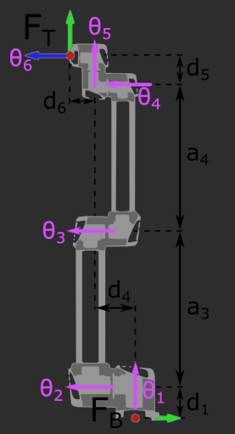
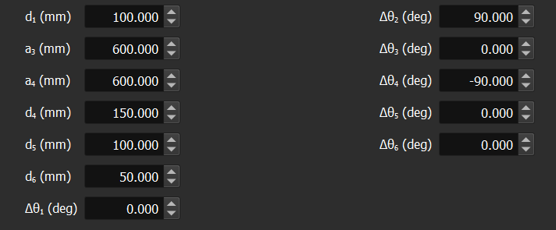
RoboDK
We need to create 6 cylinders on FreeCAD that corresponds to the 6 parts of the robot.
For it to work, the parameters d and a must be the same as those shown below
Important that the coordinate axes are the same in FreeCAD as in RoboDK.

Slide 3
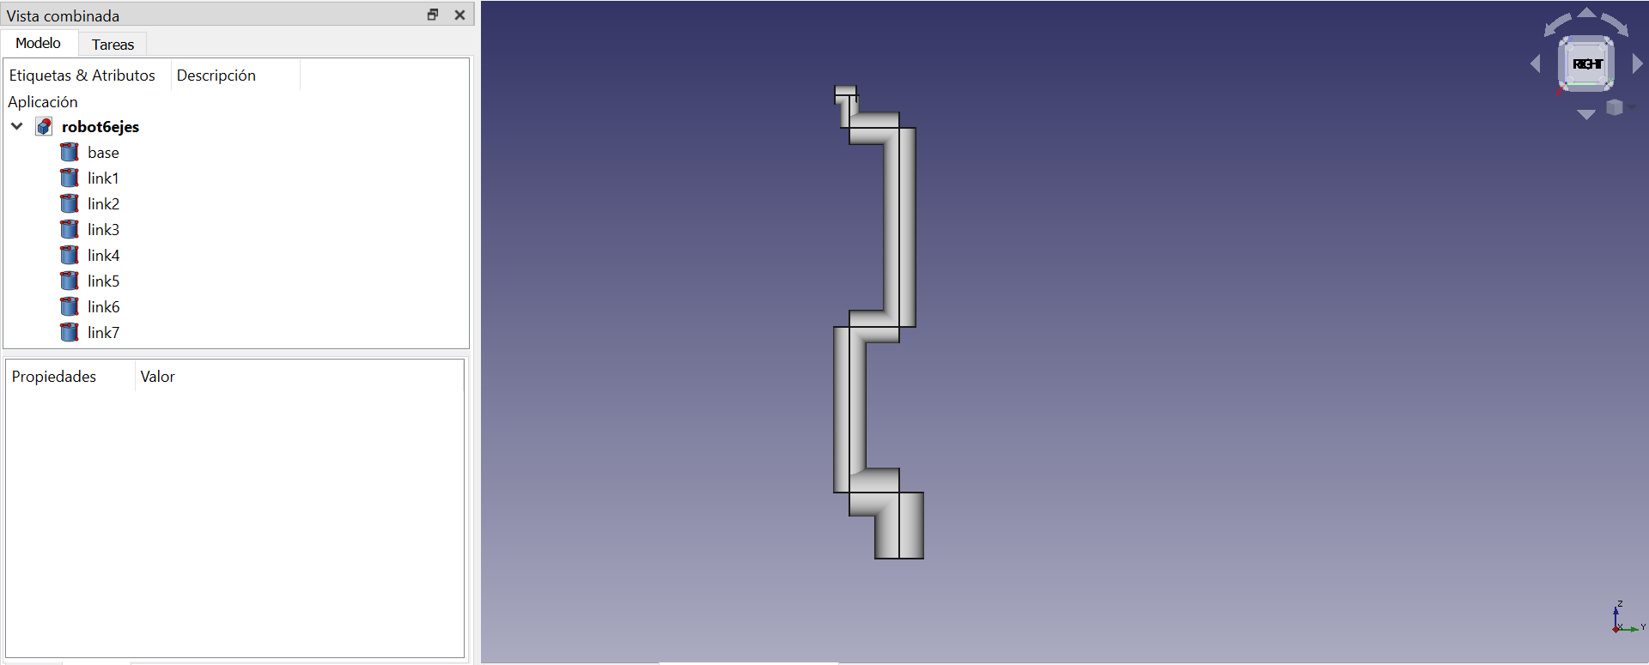
Construction of the model in FreeCAD
We need to build something like that, using the correspondings a and d parameters.

Slide 4
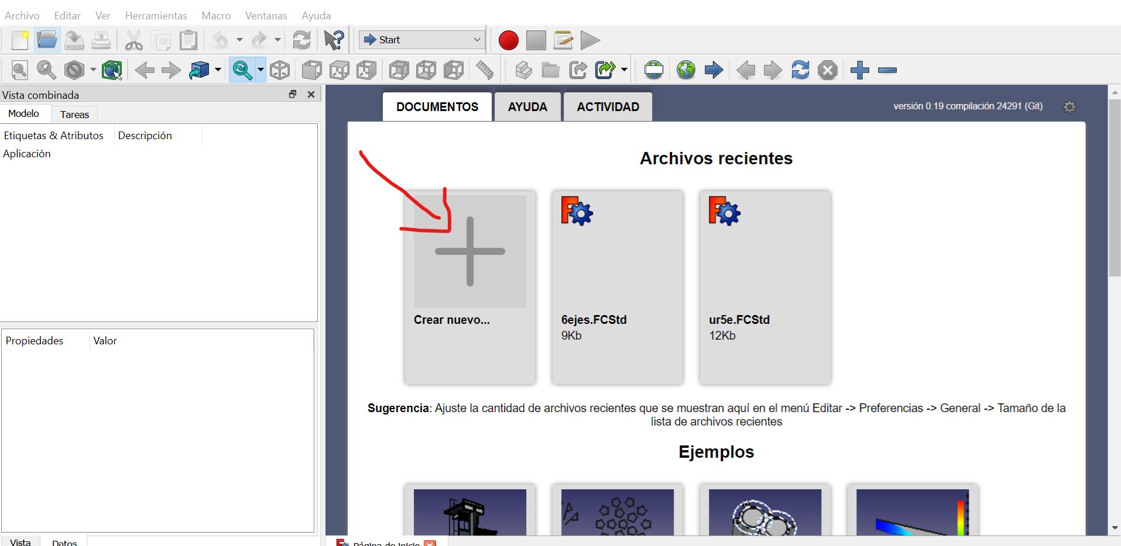
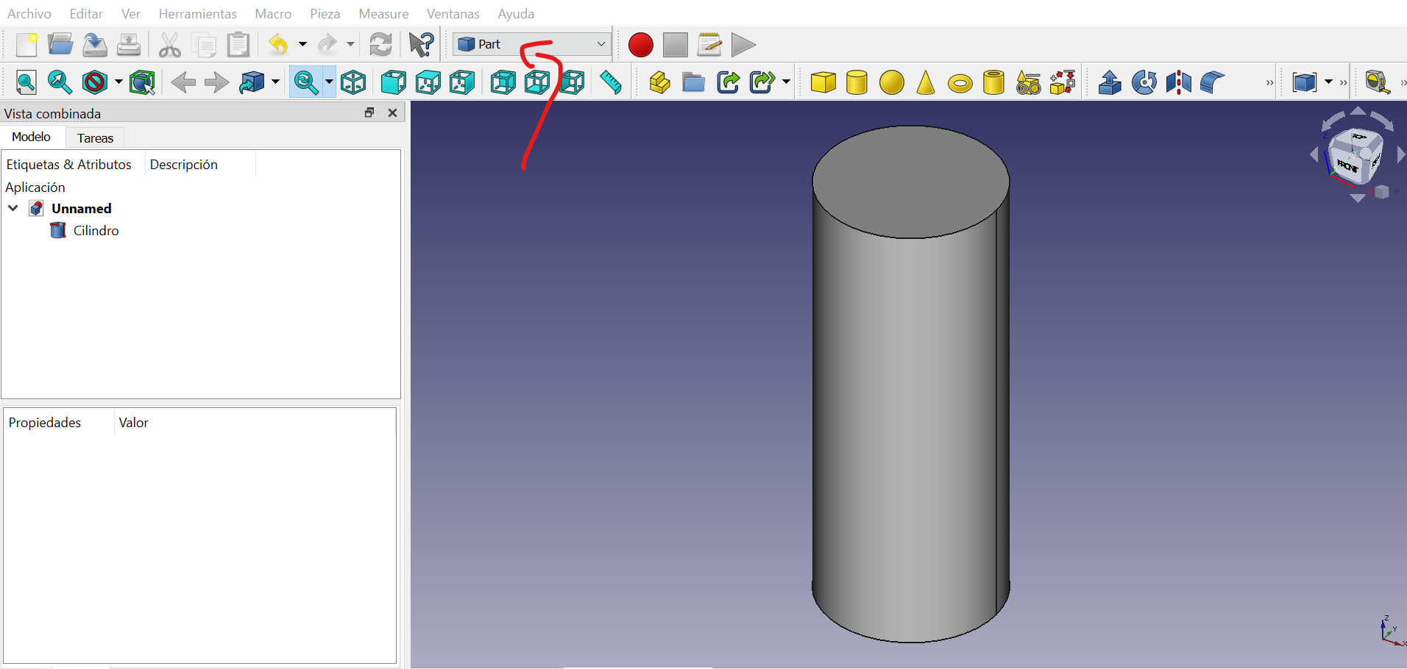
Construction of the model in FreeCAD
First, you create a new document.
Then, you select the function ‘Part’ and right now we can place the cylinders.

Slide 5
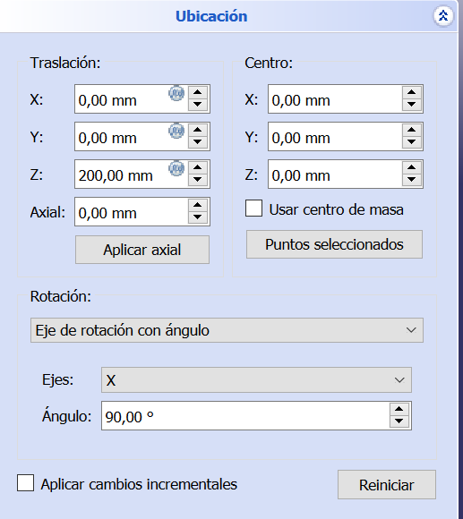
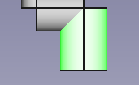
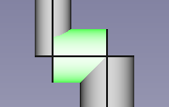
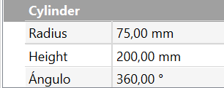
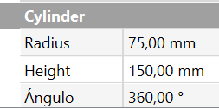
Construction of the model in FreeCAD
Base
Link 1

Slide 6
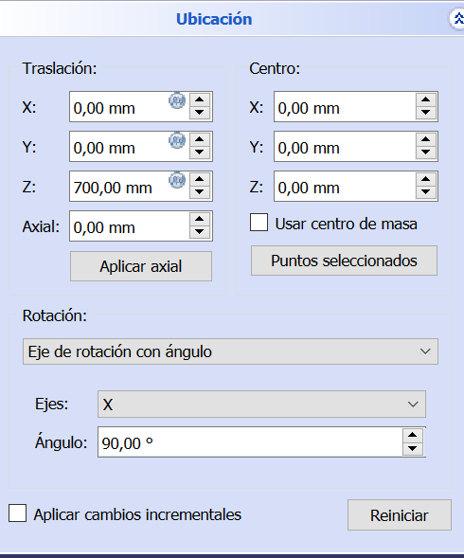
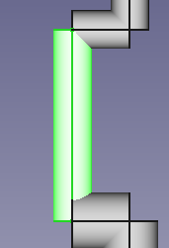
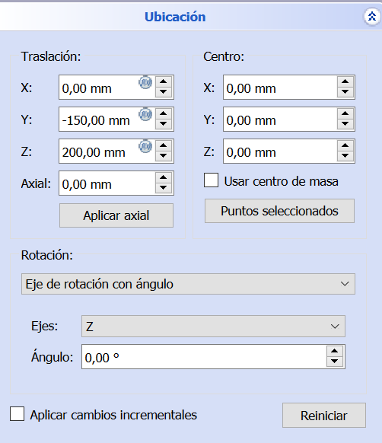
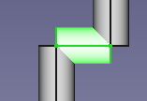
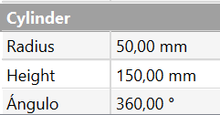
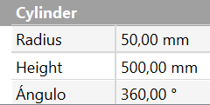
Construction of the model in FreeCAD
Link 2
Link 3

Slide 7
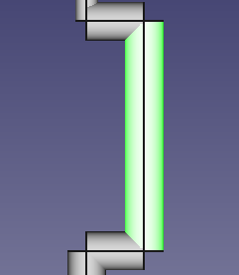
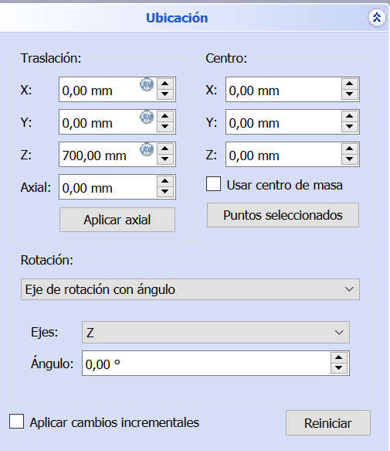
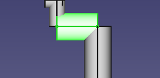
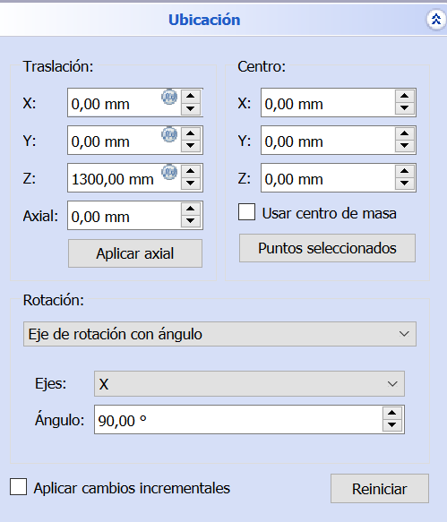
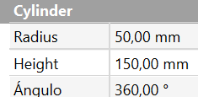
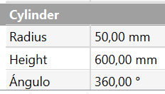
Construction of the model in FreeCAD
Link 4
Link 5

Slide 8
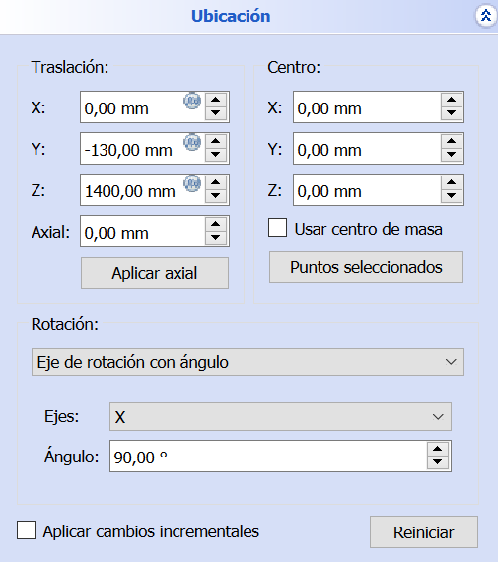
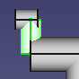
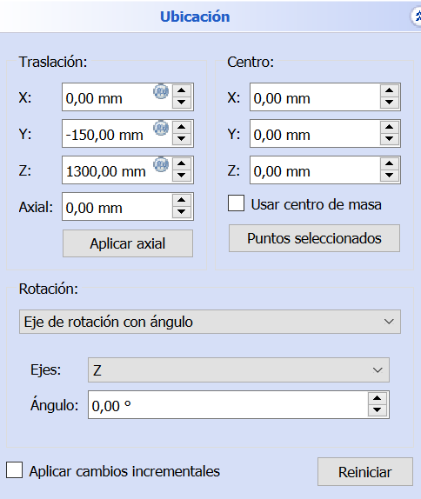

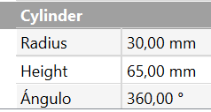
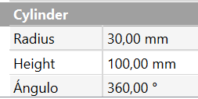
Construction of the model in FreeCAD
Link 6
Link 7

Slide 9
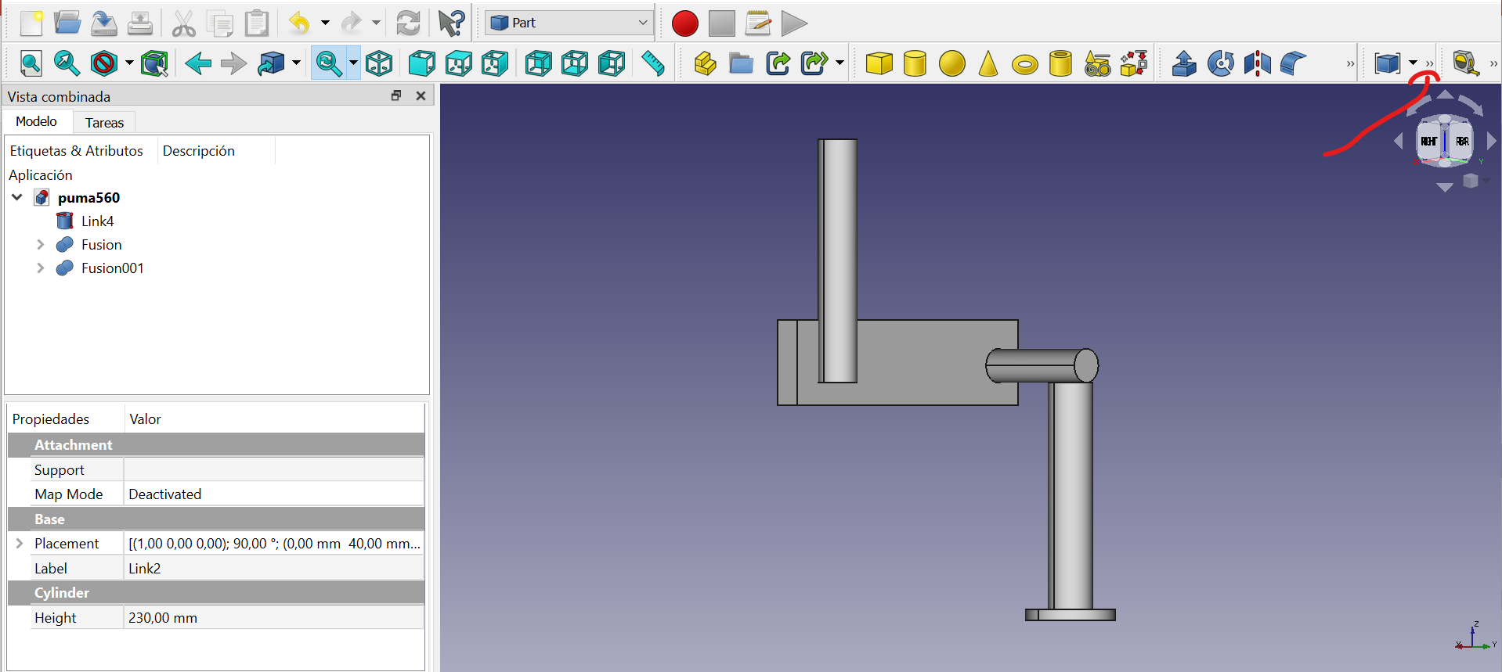
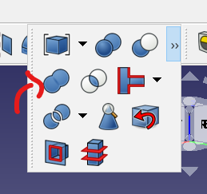
Construction of the model in FreeCAD
Finally, we need to export the parts on the format ‘.stl’.
We click on one of the cylinders and then, ‘File’ → ‘Export’ → and select the .stl format.
TIP: to combine different structures on FreeCAD we need to go on the function ‘Part’, select the structures that we want to combine, then click on in the two little arrows shown in the image on the left and finally, select the item show in the image on the right.

Slide 10
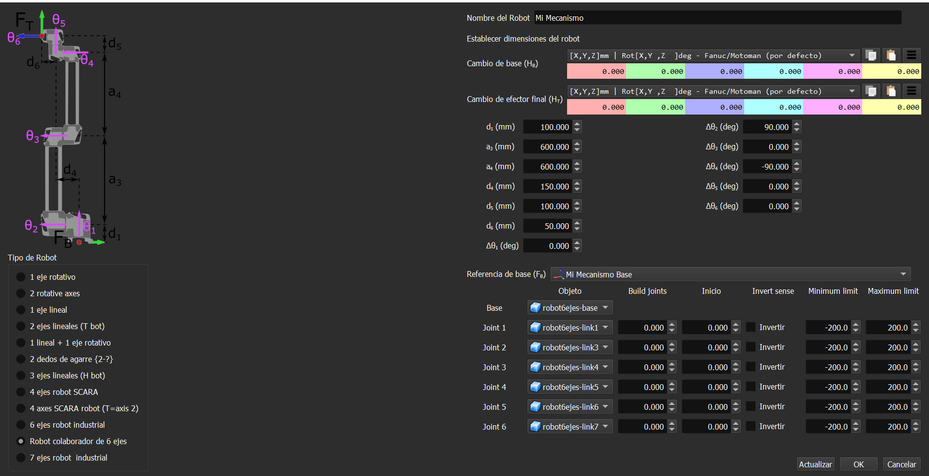
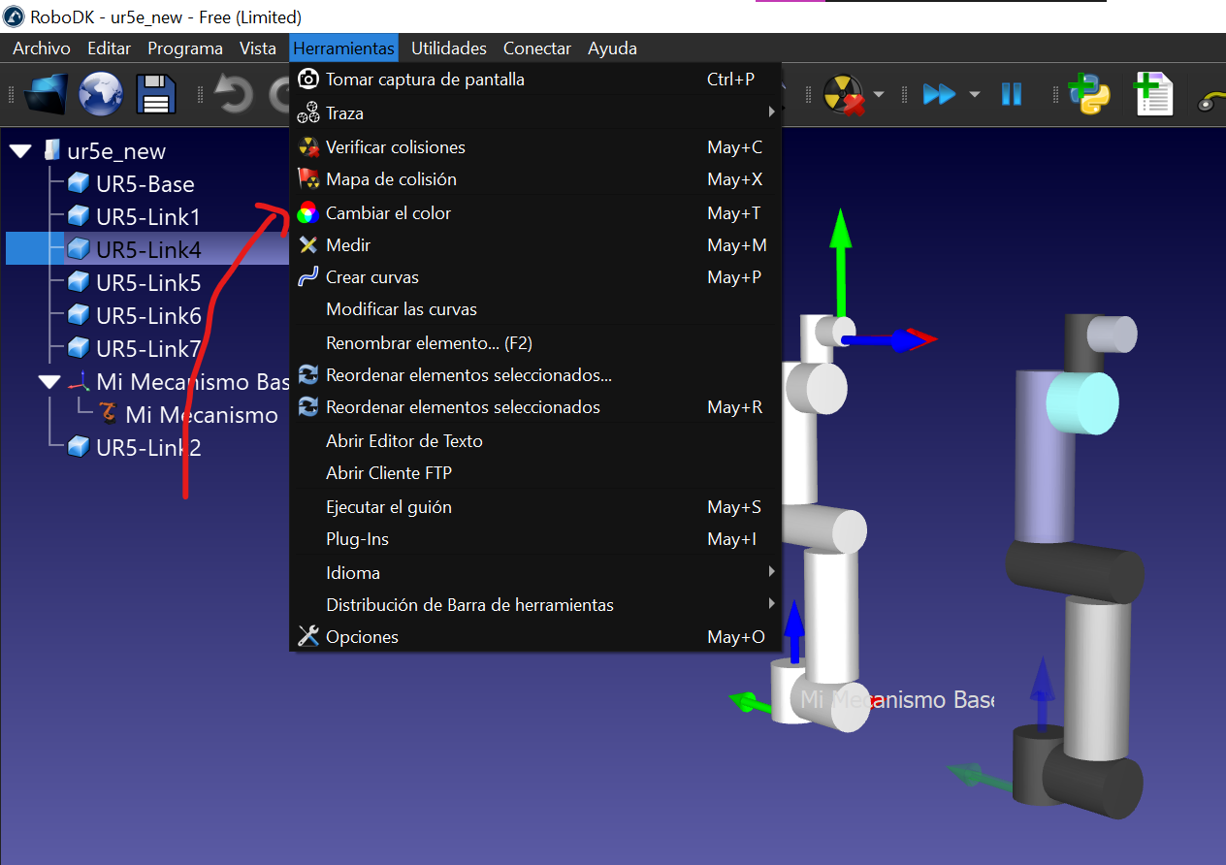
RoboDK
Once the links have been created in FreeCAD, we go to RoboDK → Utilities → Model Mechanism or Robot.
And the type of Robot is: 6-axis collaborative robot
We need to combine the link 2 with the link 3.
Then, place it as shown on the picture.
TIP: If you want to change the color of the surface you can click on ‘Tools’ and then ‘Change color’, as shown in the image.

Slide 11
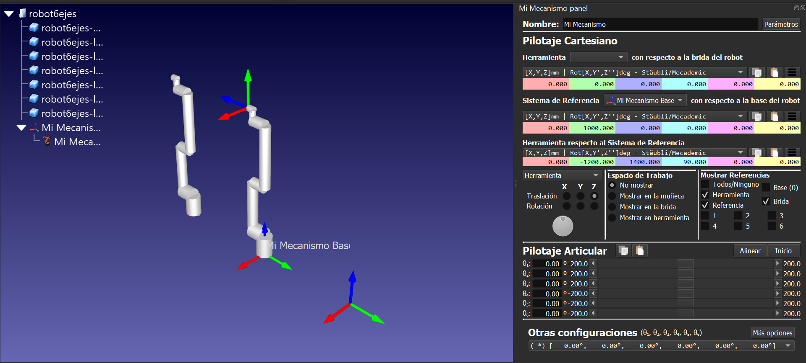
RoboDK
Now, we can move the robot.

Slide 12
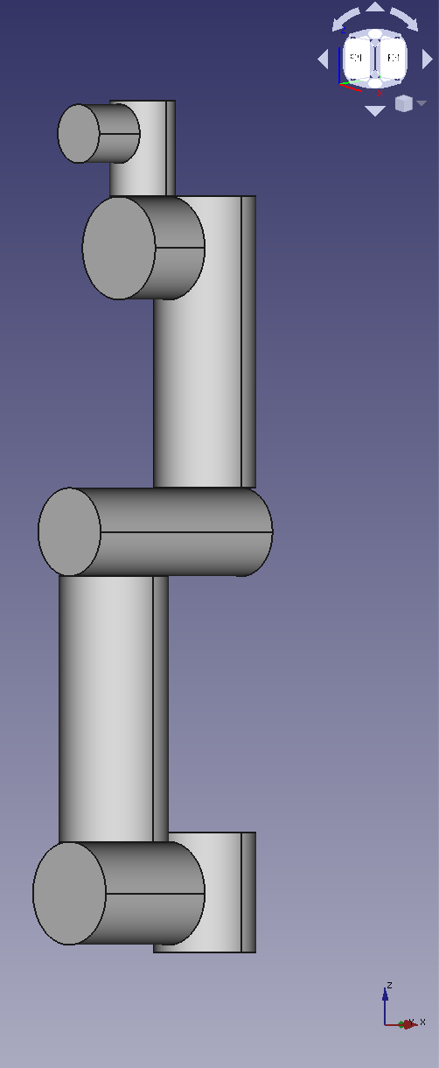
UR5e FreeCAD
This is the general structure of UR5e build in FreeCAD.
On the next slides, we are going to observe the measure and position of each link taking into account the DH parameters.

Slide 13
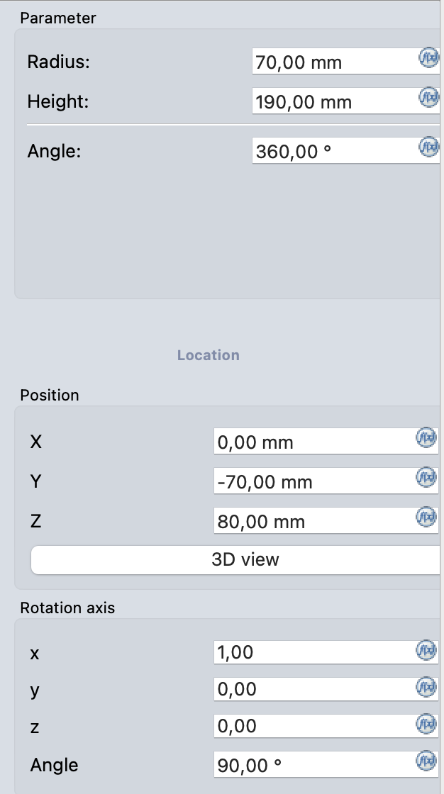
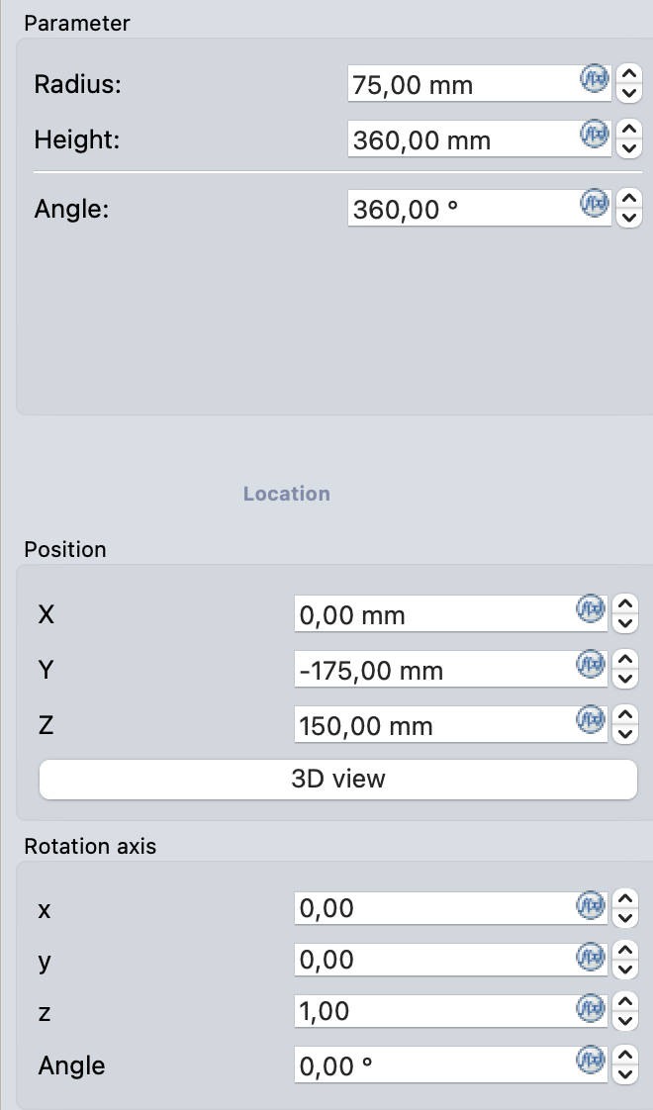
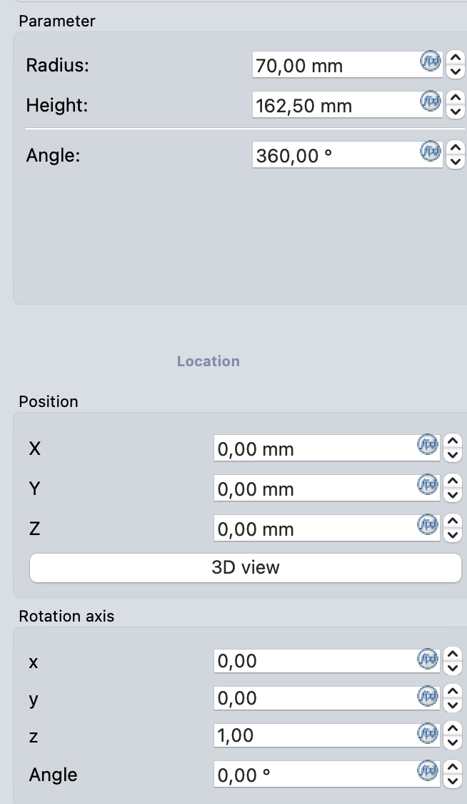
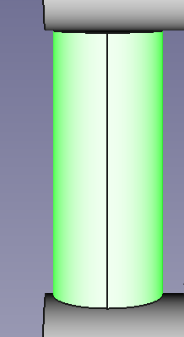
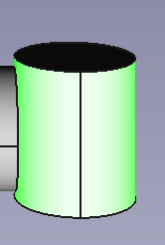
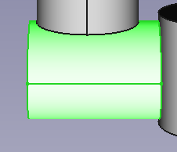
UR5e FreeCAD
Base
Link 1
Link 2

Slide 14
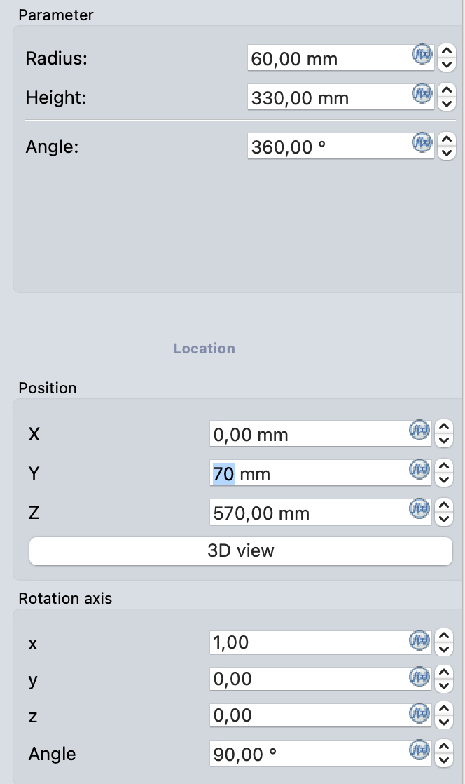
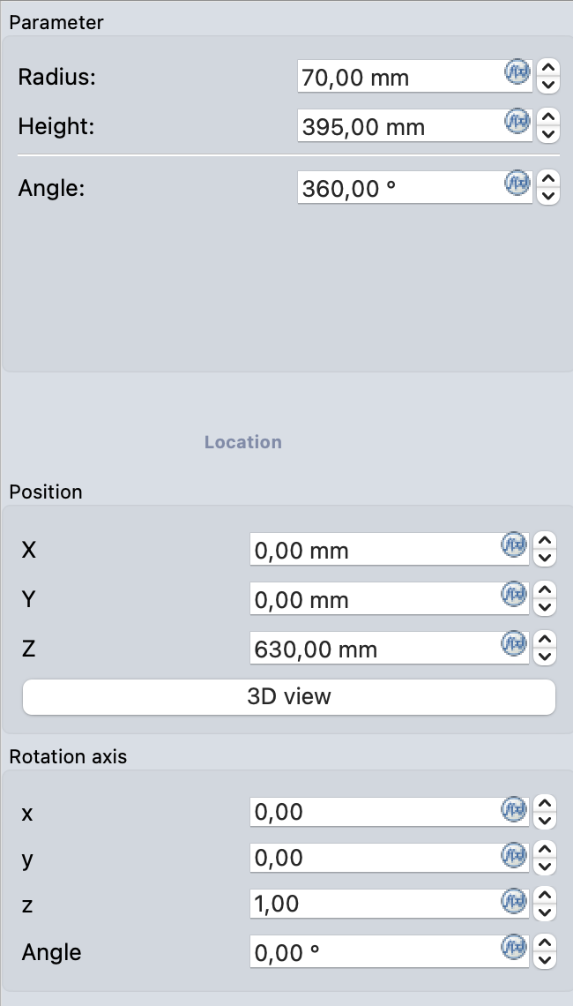
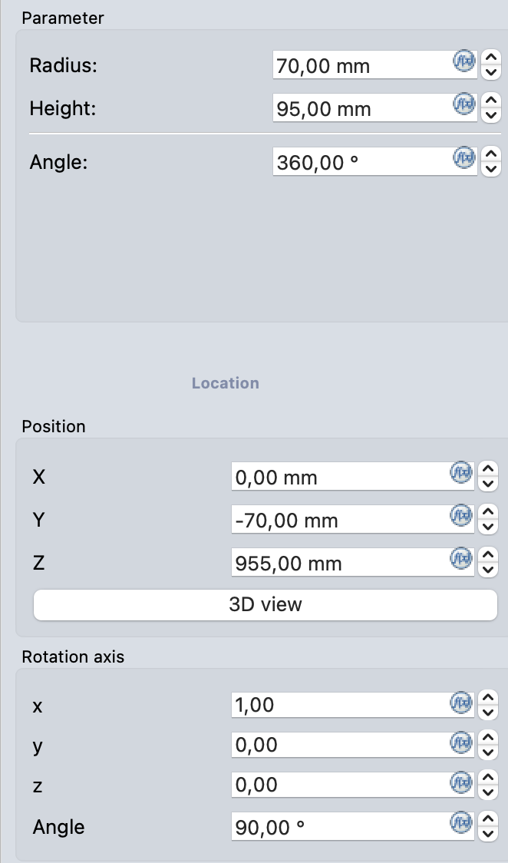
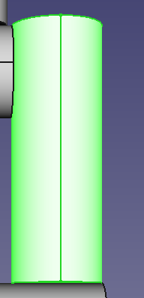
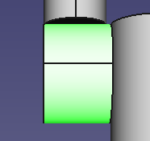
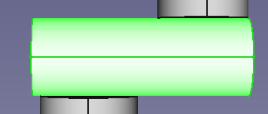
UR5e FreeCAD
Link 3
Link 4
Link 5

Slide 15
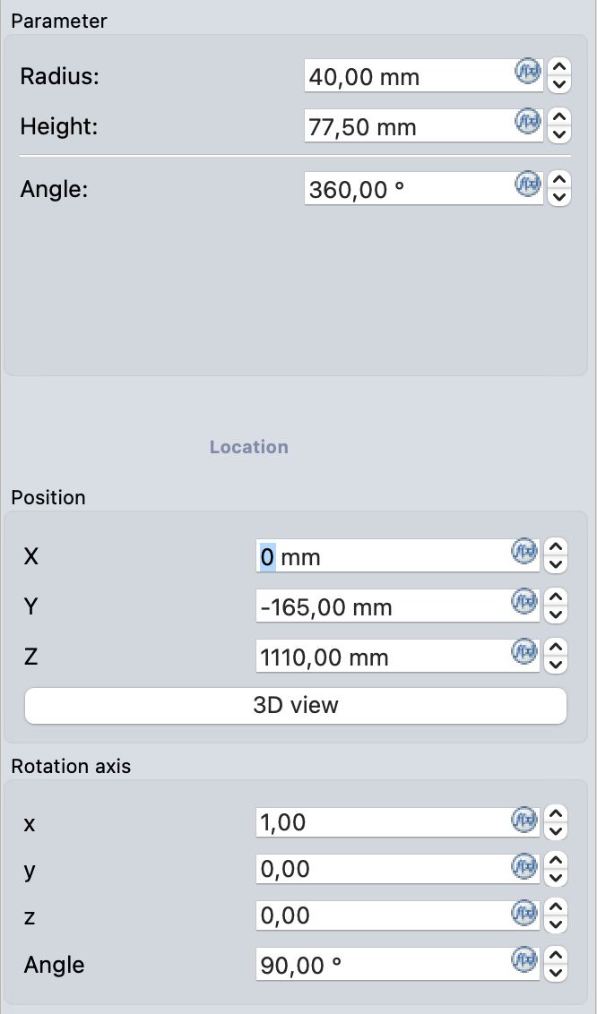
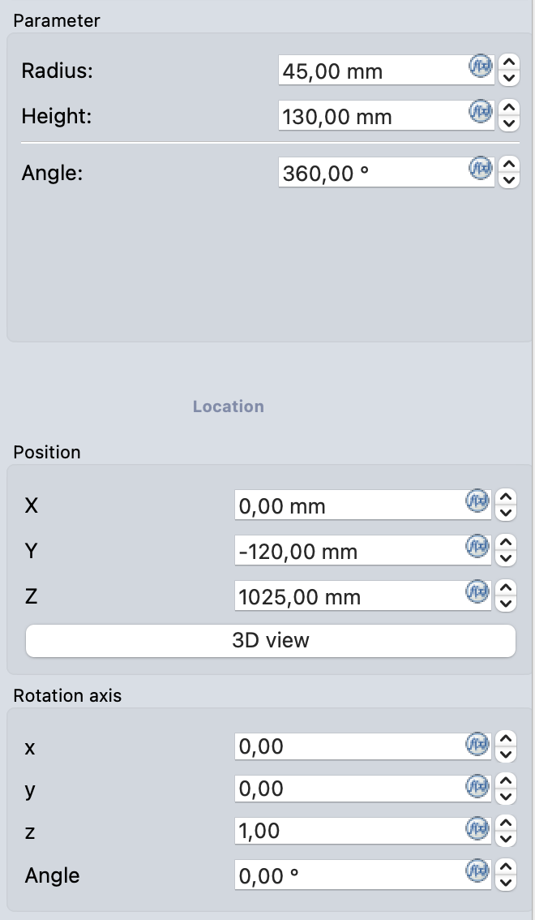
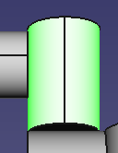
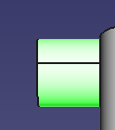
UR5e FreeCAD
Link 6
Link 7

Slide 16
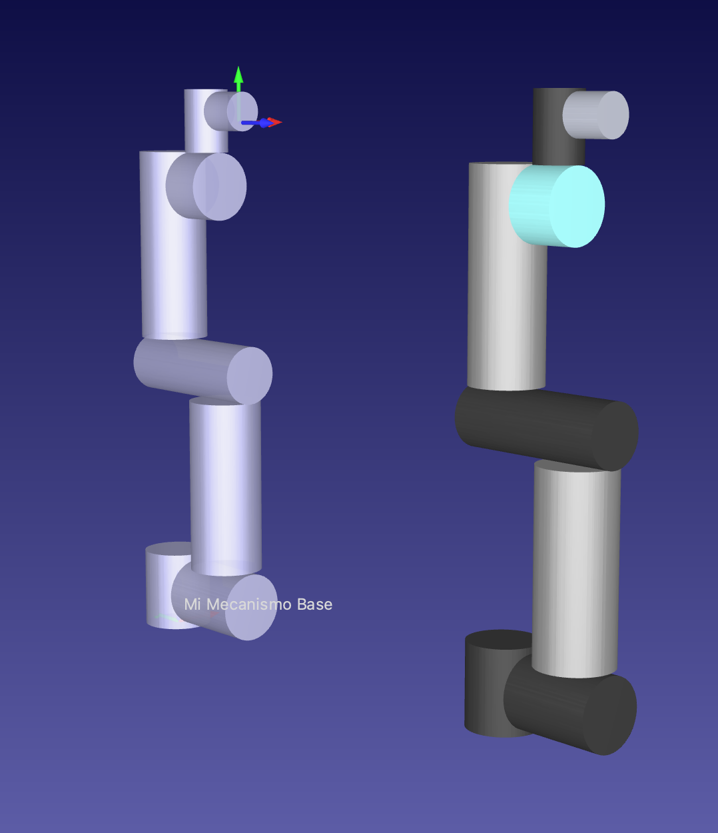

UR5e RoboDK
First of all, we need to combine Link2 and Link3, because they are going to be responsable for the same joint. In this case, we will use the type robot: 6-axis collaborative robot.
We need to define the DH parameters according to the dimensions of each link. Finally, we obtain the representation on RoboDK.

Slide 17

PUMA FreeCAD
This is the general structure of PUMA build in FreeCAD.
On the next slides, we are going to observe the measure and position of each link taking into account the DH parameters.

Slide 18






PUMA FreeCAD
Base
Link 1
Link 2

Slide 19




PUMA FreeCAD
Link 3
Link 4

Slide 20




PUMA FreeCAD
Link 5
Link 6

Slide 21


PUMA RoboDK
In this case, we will use the type robot: 6 axis industrial robot.
We need to define the DH parameters according to the dimensions of each link. Finally, we obtain the representation on RoboDK.

Slide 22
DEXARM FreeCAD
In the case of this robot, we download the stl models from the following repository: https://github.com/ybisk/robot
You have to add a small cylinder between the last two links to be able to perform all the rotations.
Then, you need to combine ln_1 with Out_1, and ln_2 with Out_2.

Slide 23


DEXARM FreeCAD
In this case, we will use the type robot: 6 axis industrial robot. The joint 4 we define 0 degrees, because this robot does not perform that rotation. Also, we can add the tool that is also on the github.
We need to define the DH parameters according to the dimensions of each link. Finally, we obtain the representation on RoboDK.

